Slide 1
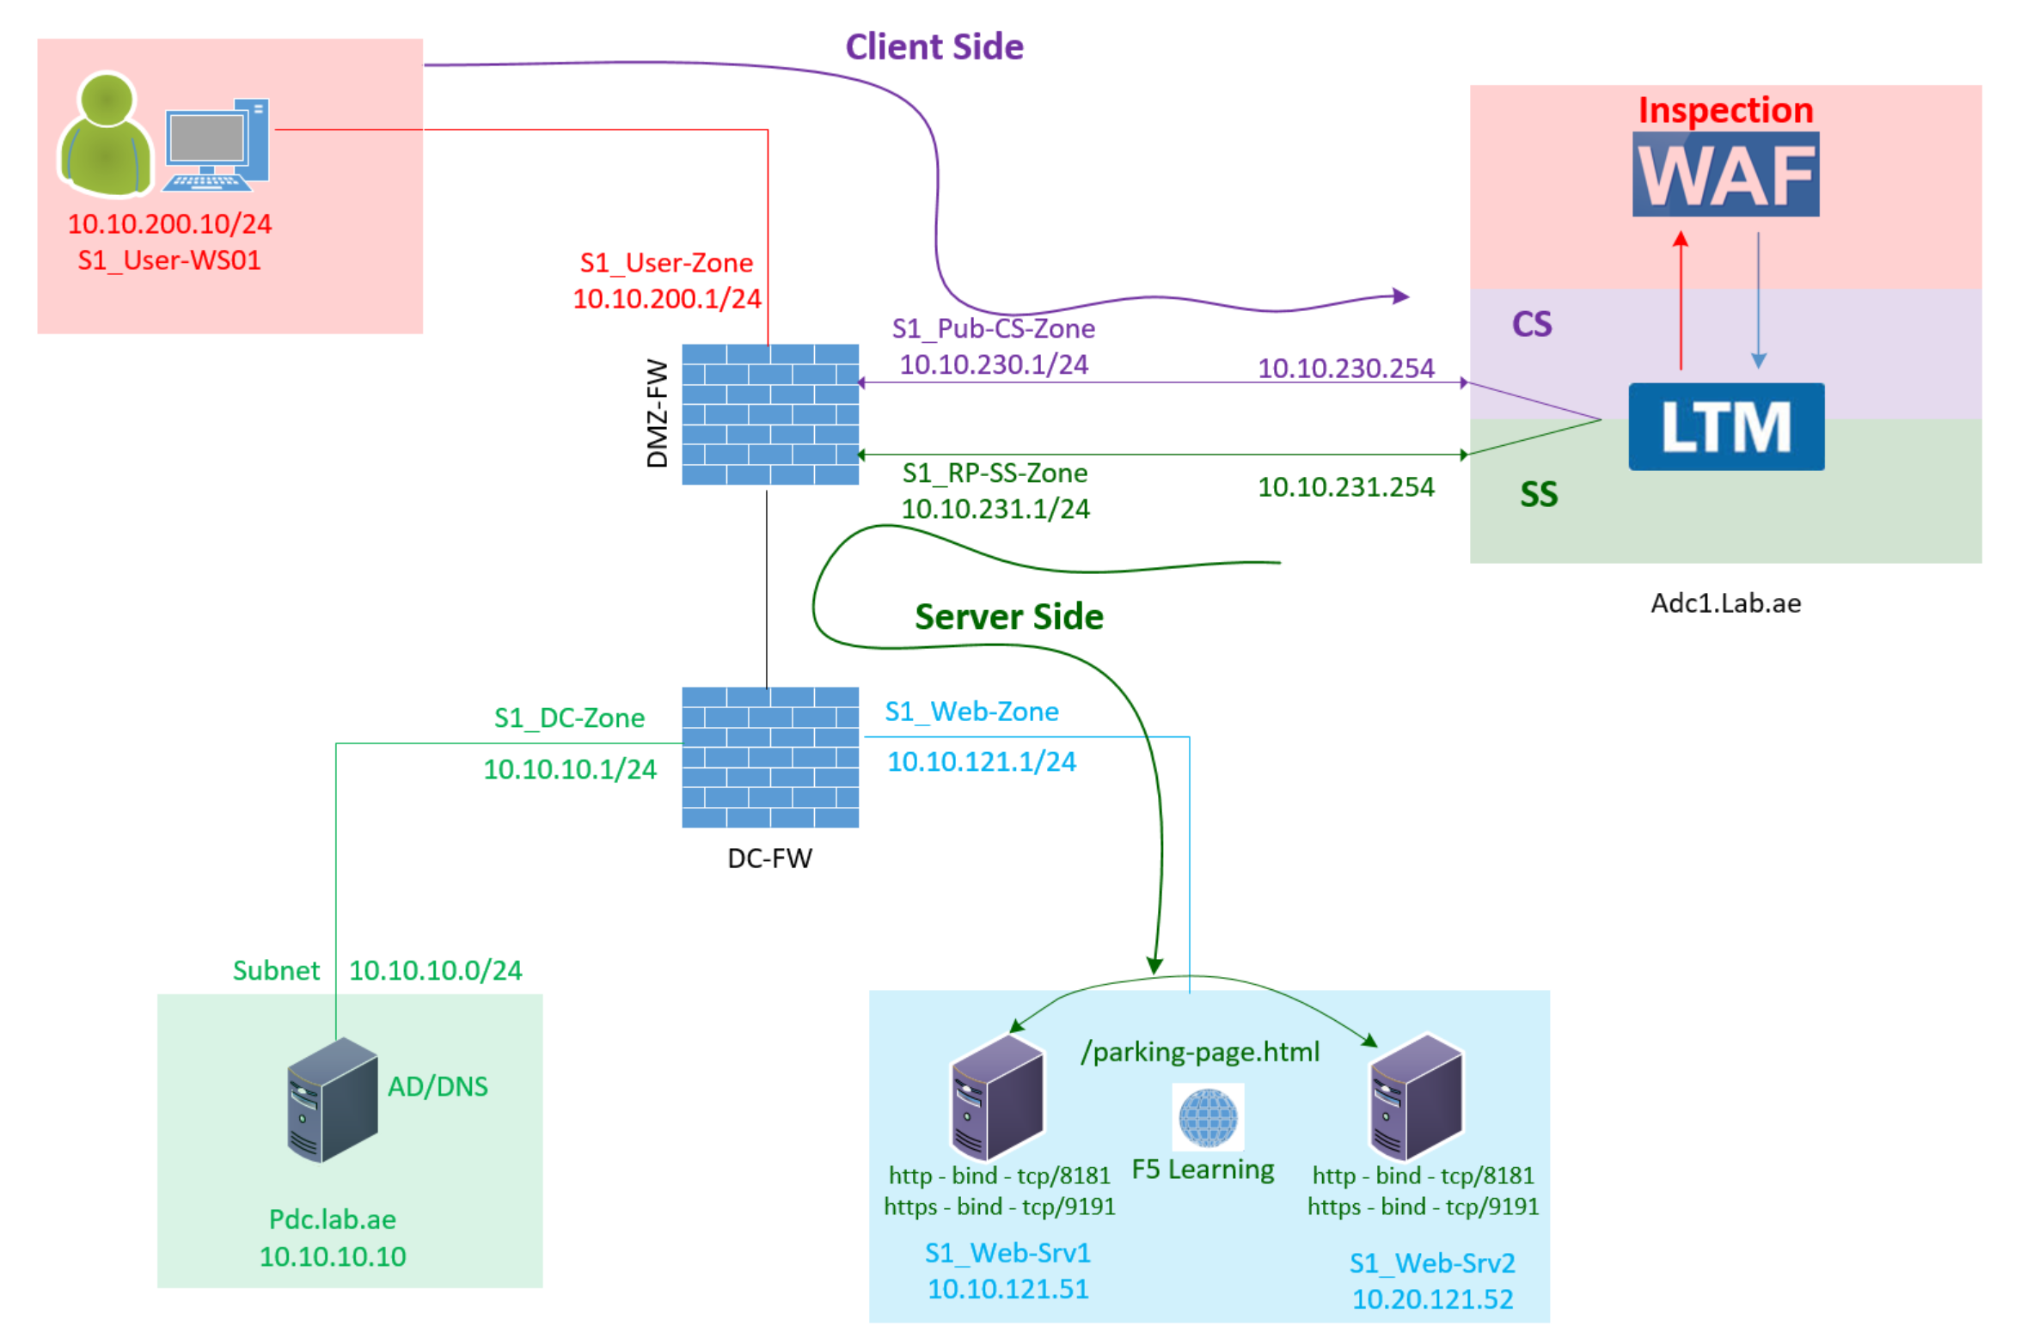

F5 LTM Learning with
Alexander S
Chapter 06 – Configure the Nodes, Pools, Pool Members and Health Monitors

Slide 2
Chapter 06 – Configure the Nodes, Pools, Pool Members and Health Monitors
This chapter is a continuation of Chapter 05.
If you haven’t watched Chapter 05, I highly recommend watching it before this chapter.

Slide 3
Chapter 06 – Configure the Nodes, Pools, Pool Members and Health Monitors
Step 01: Configure the Nodes?
Step 02: Configure the Pools and Pool Members?
Step 03: Configure the health monitors and apply them to the pools.

Slide 4
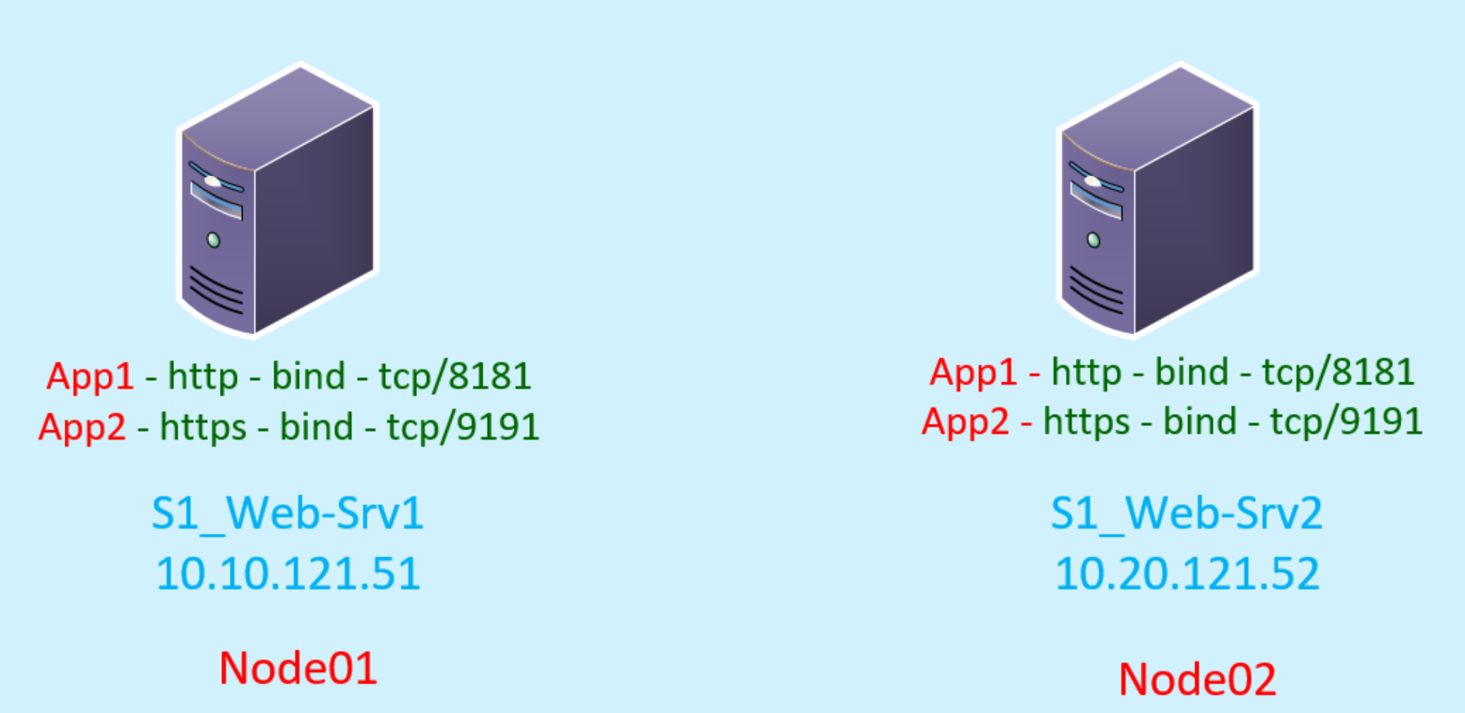
Step 01 : Configure the Nodes
1.1. Create a node01 in F5
We will configure two nodes.
  s1_web-srv01
  s1_web-srv02
Type the node01 name as s1_web-srv01
we can use either an IP Address or an FQDN
Choose FQDN as the address type, when the node IP address changes dynamically.
FQDN, it will dynamically populate the IP address using DNS resolution.
The S1_Web-Srv01 uses a static IP 10.10.121.51

Slide 5
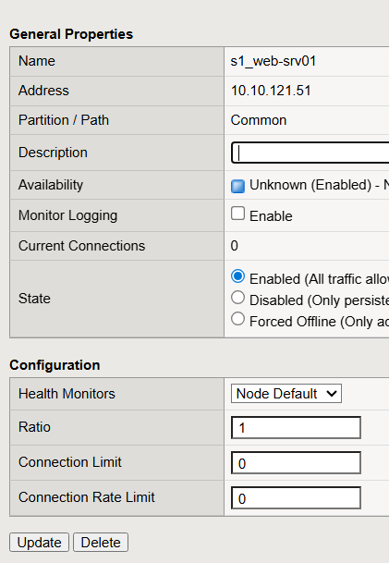
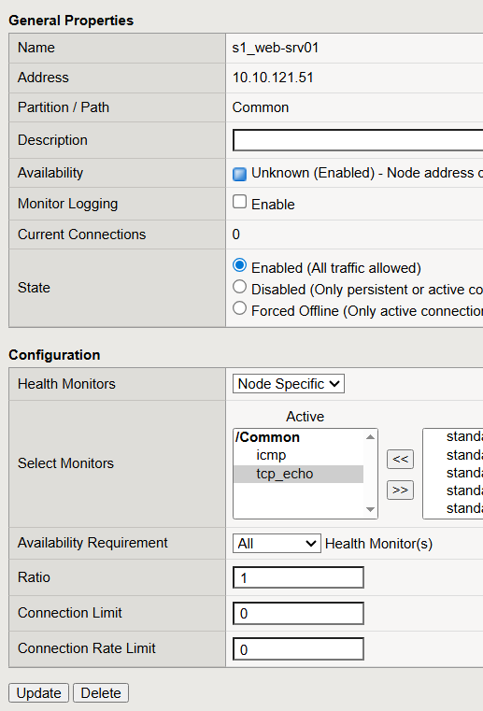
Step 01 : Configure the Nodes
1.2. Node Health Monitor in F5
A node health monitor checks the availability of the web server itself.
Two types of Node Health Monitor in F5.
  Node Default
  Node Specific
Node Default
Node Specific

Slide 6
Step 01 : Configure the Nodes
1.3. Node Default vs Node Specific Health Monitors
Node Default means:
  A default monitor is configured in the F5 global settings.
  That monitor will be used automatically when a new node is created with default settings.
  There is no default monitor configured in F5 Global Settings.
  Node Specific means:
  It allows you to manually select the monitor type for that specific node.
  You can select multiple monitors.
Node Default
Node Specific

Slide 7
Step 01 : Configure the Nodes
1.4. Node Health Monitors is optional
As a best practice, we usually do not monitor the node itself, because pool member monitors already verify the actual service (like HTTP or HTTPS) running on the server.
Monitoring the node separately using icmp ping may create unnecessary loads on the web server.
Set the node Health monitor settings to None.

Slide 8
Step 01 : Configure the Nodes
1.5. Create a node02 in F5
Type the node02 name as s1_web-srv02
we can use either an IP Address or an FQDN
The S1_Web-Srv02 uses a static IP 10.10.121.52
Choose the health monitor settings to None.

Slide 9
Step 02: Configure the Pools and Pool Members in F5
Pool 1 → Web App 1
  Node1:8181
  Node2:8181
Pool 2 → Web App 2
  Node1:9191
  Node2:9191
Pool 1 → Learning-Portal_Http-Pool
  S1_Web-Srv01:8181
  S1_Web-Srv02:8181
Group 01 = Pool 1
(http app)
Instance
Member
Instance
Member
Instance
Pool 2 → Learning-Portal_Https-Pool
  S1_Web-Srv01:9191
  S1_Web-Srv02:9191
Group 02 = Pool 2
(https app)
Member
Instance
Member

Slide 10
Step 03: Configure the health monitors and apply them to the pools
Without checking service availability, it is not a good practice to send user requests to the web server.
This can lead to service access failures if the web application is not available on that server.

Slide 11
Step 03: Configure the health monitors and apply them to the pools
We want to send an actual HTTP request as a health monitor.
In our case, the web application is configured on web server01 and web server02.
For example, we can access web server01 using the URL:
  http://10.10.121.51:8181/parking-page.html
Before configuring the health monitor, we need to test this URL from the F5 CLI.

Slide 12
Step 03: Configure the health monitors and apply them to the pools
How can we test this?
  Using curl.
Let us log in to the F5 CLI and test it using the following command:
  curl -ivk http://10.10.121.51:8181/parking-page.html

Slide 13
Step 03: Configure the health monitors and apply them to the pools
HTTP Request Header
GET /parking-page.html HTTP/1.1
Host: 10.10.121.51:8181
User-Agent: curl/7.47.1
Accept: */*

Slide 14
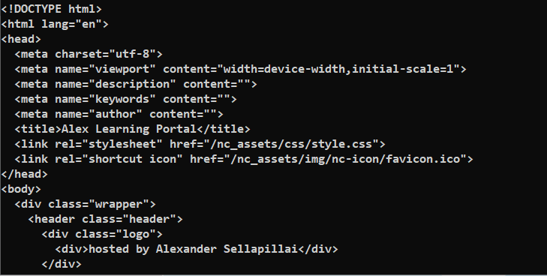
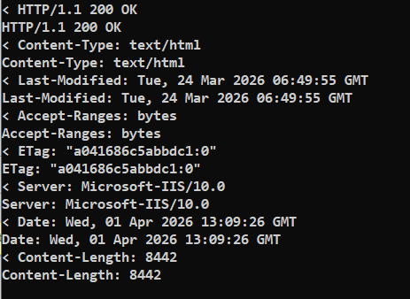
Step 03: Configure the health monitors and apply them to the pools
HTTP Response Header & Response Body
Response Body
Response Header

Slide 15
Step 03: Configure the health monitors and apply them to the pools
Craft a health monitor in F5 using this CURL input
curl -ivk http://learning-portal.lab.ae:8181/parking-page.html
GET /parking-page.html HTTP/1.1
Host: learning-portal.lab.ae:8181
User-Agent: curl/7.47.1
Accept: */*

Slide 16
Step 03: Configure the health monitors and apply them to the pools
Configure the health Monitors in F5
We will configure two types of health monitor in F5
Learning-Portal_Http-monitor
Learning-Portal_Https-monitor

Slide 17
Step 03: Configure the health monitors and apply them to the pools
Configure the Learning-Portal_Http-monitor – Time Interval
The Time Interval tells F5 how frequently it should check the availability of the web application.

Slide 18
Step 03: Configure the health monitors and apply them to the pools
Configure the Learning-Portal_Http-monitor – Timeout
The Timeout defines when F5 should consider the web application as unavailable.
If three consecutive health checks fail, the application will be marked as down.
Since our interval is 10 seconds, the calculation is:
3 × 10 = 30 seconds

Slide 19
Step 03: Configure the health monitors and apply them to the pools
Configure the Learning-Portal_Http-monitor – Send String
In the Send String, we need to include:
HTTP method
URL
Protocol version
Hostname
The syntax is as follows:
GET /parking-page.html HTTP/1.1\r\nHost: learning-portal.lab.ae\r\n\r\n
    \r\n means Carriage Return + Line Feed (it is for line break).
    It is used to separate lines in an HTTP request.
With Carriage Return + Line Feed , f5 will read the request like this
GET /parking-page.html HTTP/1.1\r\n → Request URL along with the protocol type on the first line
Host: learning-portal.lab.ae\r\n → HTTP Host header on the second line
\r\n → Blank or Empty value on the third line.
The blank line indicates the end of HTTP headers.

Slide 20
Step 03: Configure the health monitors and apply them to the pools
Configure the Learning-Portal_Http-monitor – Receive String
The Receive String defines what F5 want to see in the server’s response for F5 to consider the application as healthy.
F5 reads only the first 5120 bytes of the response.
Need to ensure that our expected string appears within the F5 read range which is 5120 bytes.
To verify this, we can use curl and limit the output to the first 5120 bytes:
curl -ivk http://10.10.121.51:8181/parking-page.html | head -c 5120
This command shows the first 5120 bytes of the response, which F5 will evaluate.
From this output, you can choose any consistent value as the Receive String.
Common approaches include:
  Using the HTTP status: 200 OK
  Using a specific keyword from the page content
  Using the HTML title
In this example, we will use the title from the web page as the Receive String.

Slide 21
Step 03: Configure the health monitors and apply them to the pools
Configure the Learning-Portal_Http-monitor – Receive Disable String
What is receive disable string?
The Receive Disable String which f5 do not want to see in the response.
For example, a response like:
  500 Internal Server Error
If F5 see this string in the response,
  It will mark the pool member status as disabled.
Important Note:
  To use this feature, you must specify both a Receive String and a Receive Disable String.
  For this condition to work - Receive String should not match and Receive Disable String should match.
  If this condition match - F5 put the node in disabled state.
  If the condition change - meaning when we started seeing the correct receive string
  Pool member released disabled state to online
In this example, we will not configure the Receive Disable String.

Slide 22
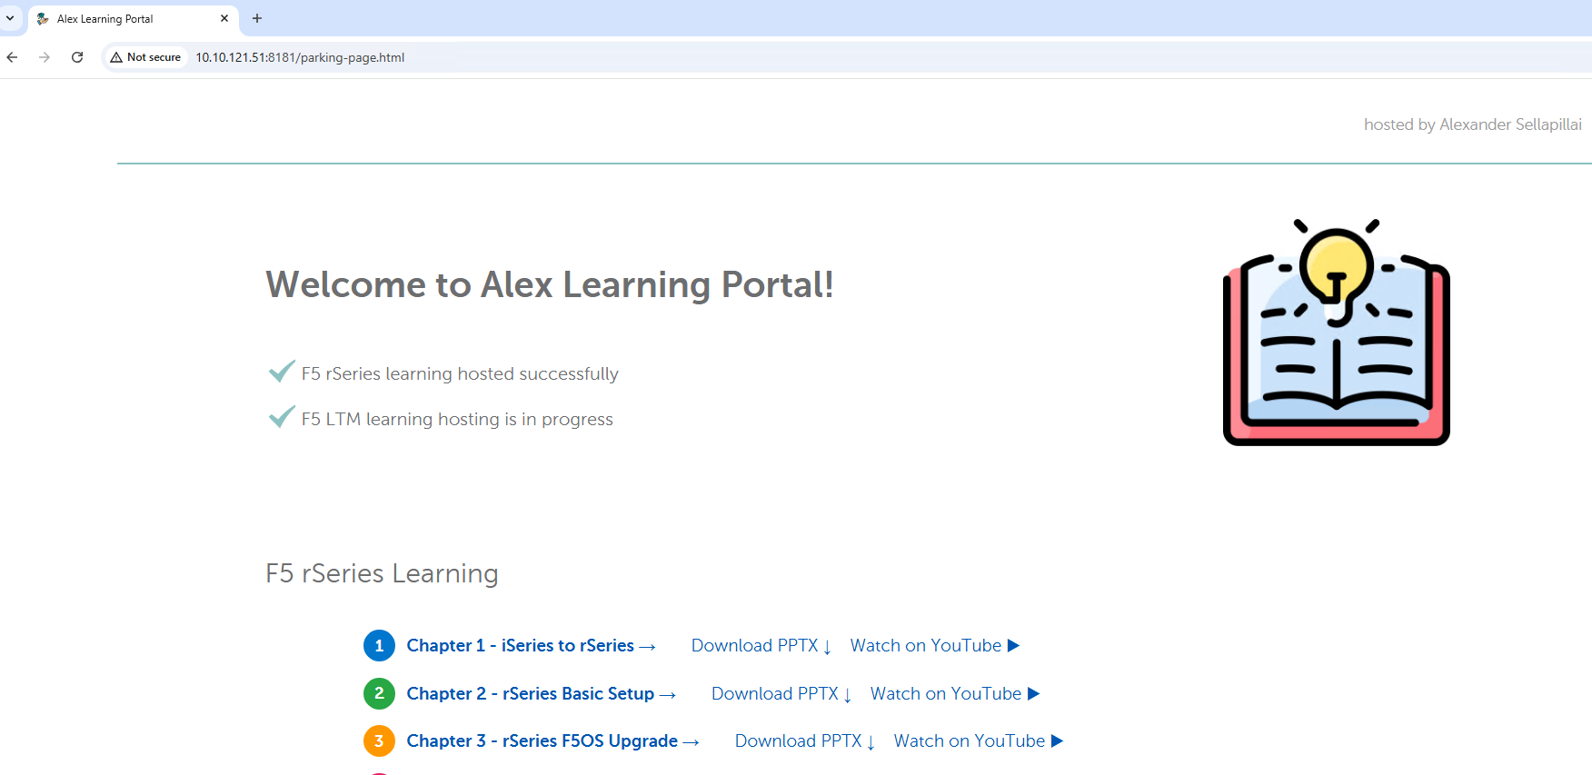
Step 03: Configure the health monitors and apply them to the pools
Configure the Learning-Portal_Http-monitor – Authentication
Sometimes, the monitoring URL may be protected with authentication.
In such cases, you can provide credentials by specifying a username and password.
In this example, we will not configure credentials because /parking-page.html is public and does not require authentication.

Slide 23
Step 03: Configure the health monitors and apply them to the pools
Configure the Learning-Portal_Http-monitor – Alias Service Port
This setting tells the F5 which port the monitor should use when checking the target server.
We know that the learning-portal-http application is running on port 8181,

Slide 24
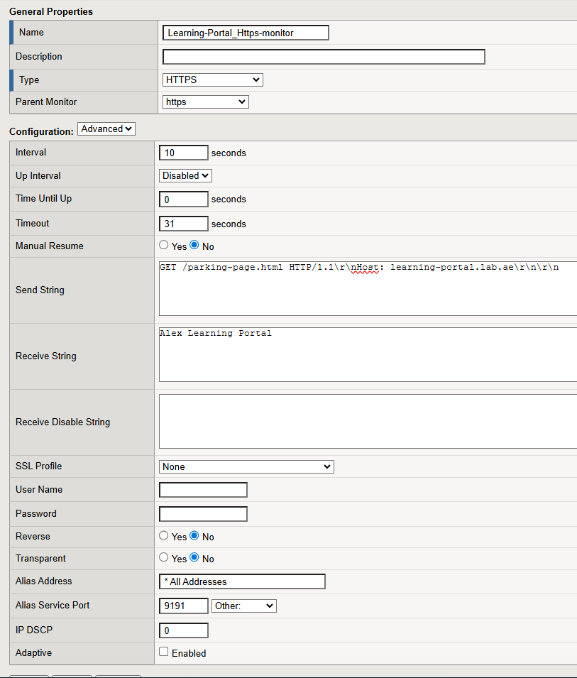
Step 03: Configure the health monitors and apply them to the pools
Configure the Learning-Portal_Https-monitor
How this is difference from http monitor ?
  Alias Port
  SSL profile

Slide 25
Step 03: Configure the health monitors and apply them to the pools
Configure the Learning-Portal_Https-monitor – Alias Port
Alias Port
Learning portal https application configured using 9191

Slide 26
Step 03: Configure the health monitors and apply them to the pools
Configure the Learning-Portal_Https-monitor – SSL Profile
SSL Profile for Health Monitor SSL Handshake
None – F5 Uses the default SSL profile
We can specify the custom SSL profile for Health Monitor SSL handshake.

Slide 27
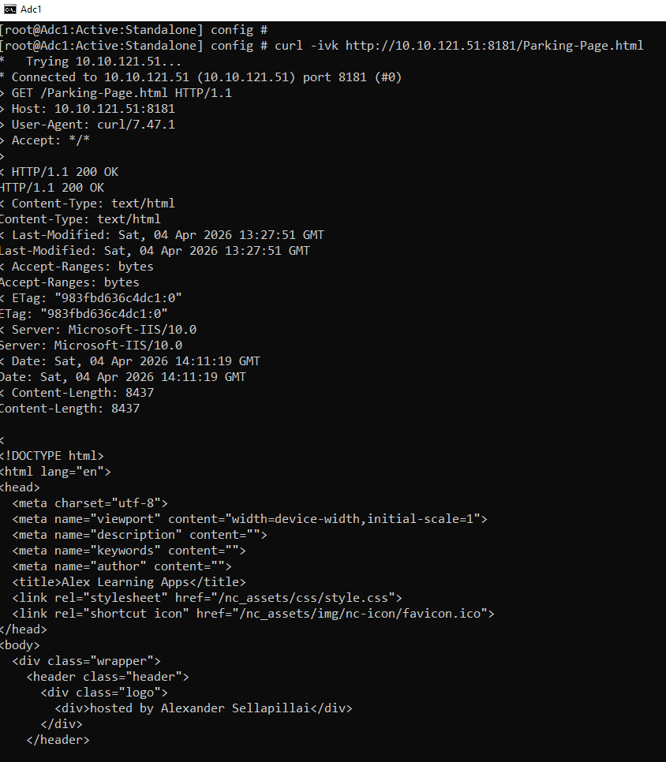
Step 03: Configure the health monitors and apply them to the pools
Troubleshooting Health Monitors
Curl
Monitor Logging

Slide 28
Step 03: Configure the health monitors and apply them to the pools
Troubleshooting Health Monitors – Check the Monitor Logging in F5 CLI
Now we have enabled the monitor logging right?
  Where to check this logging?
  We have to check this logging in F5 CLI under /var/log/monitor/
  First let us check is there a file created automatically by F5 to log this node monitor.
To check this type ls -l /var/log/monitors/
Yes! After enable the monitor logging to the pool member - F5 created this file.
Let us open the file and see using this command.
tail -f /var/log/monitors/Common_Learning-Portal_Http-monitor-Common_s1_web-srv01-8181.log

Slide 29
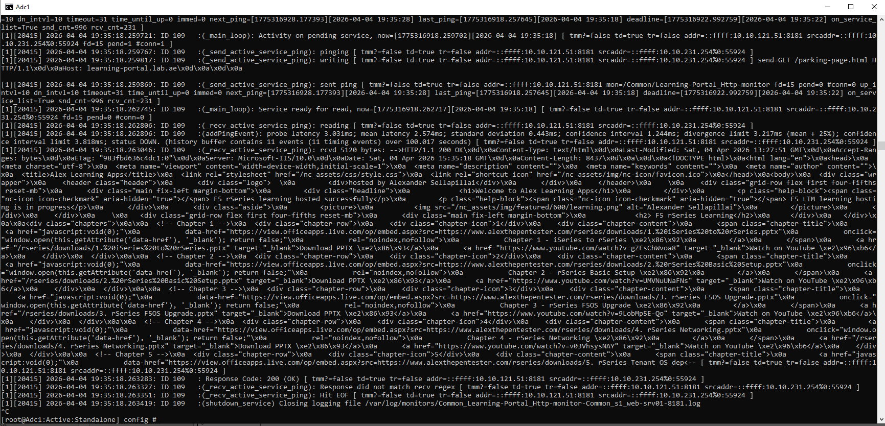
Step 03: Configure the health monitors and apply them to the pools
Troubleshooting Health Monitors – Check the Monitor Logging in F5 CLI

Slide 30
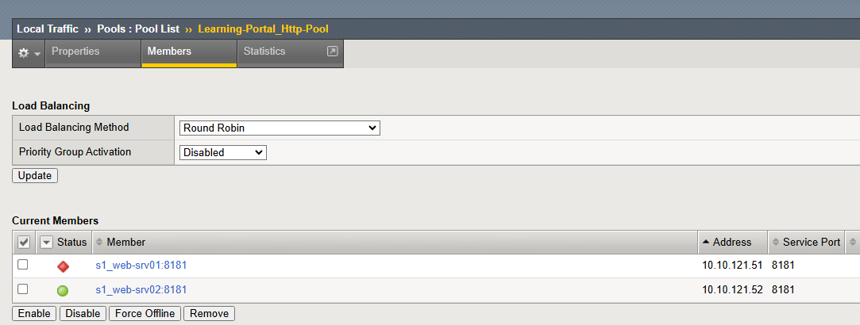
Step 03: Configure the health monitors and apply them to the pools
Troubleshooting Health Monitors – Check the Monitor Logging in F5 CLI

Slide 31
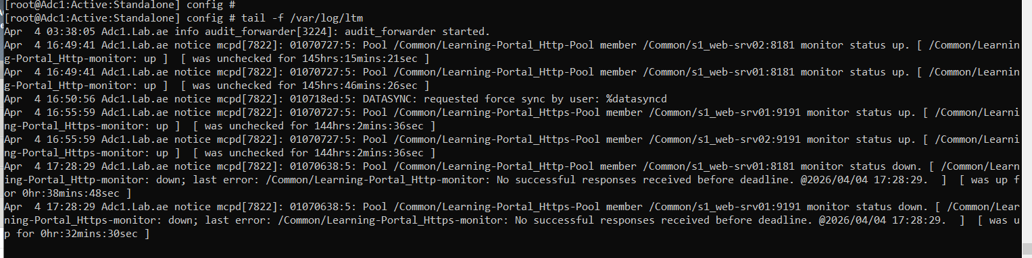
Step 03: Configure the health monitors and apply them to the pools
Troubleshooting Health Monitors – Check the Monitor Logging in F5 CLI
When the application Changes Takes place?
  LTM logs reveal this info
/var/log/ltm

Slide 32
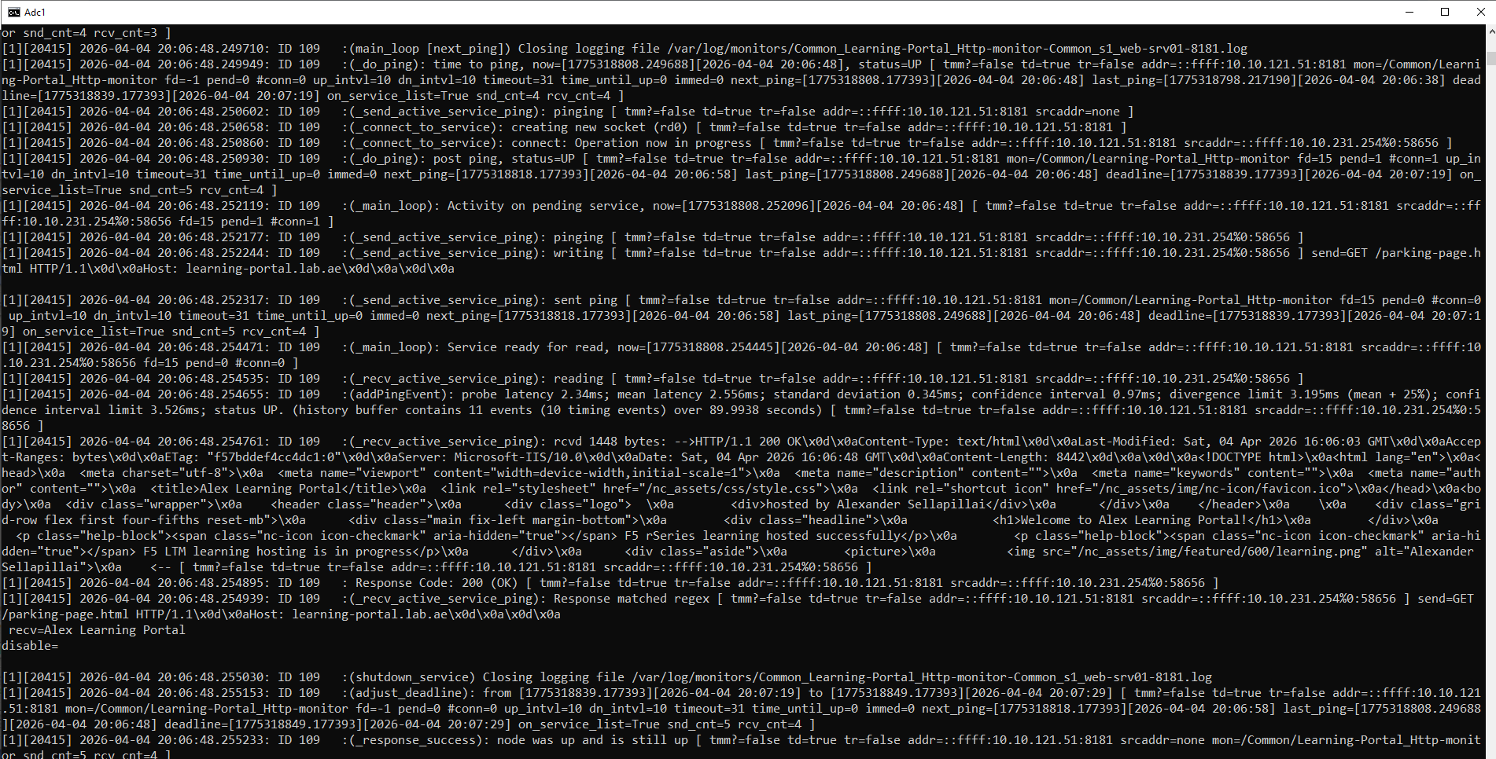
Step 03: Configure the health monitors and apply them to the pools
Troubleshooting Health Monitors – Check the Monitor Logging in F5 CLI

Slide 33
This concludes the Chapter 06.
In this chapter, we learned how to configure nodes, pools, pool members, and health monitors.
Continue to watch chapter 07 - Where we will explore and configure the f5 profiles.
Thank you for watching.
Chapter 06 – Configure the Nodes, Pools, Pool Members and Health Monitors

